Slide 1
Amir Dirin
Spring 2023

Slide 2
Usability and Evaluation
Usability and evaluation are closely related concepts
Usability means that the HCI design of the system supports the user’s cognitive and ergonomic limitations and is easy to use and learn
Evaluation means to assess the system for functionality as well as usability
We explore how to compare, assess, and improve interfaces

Slide 3
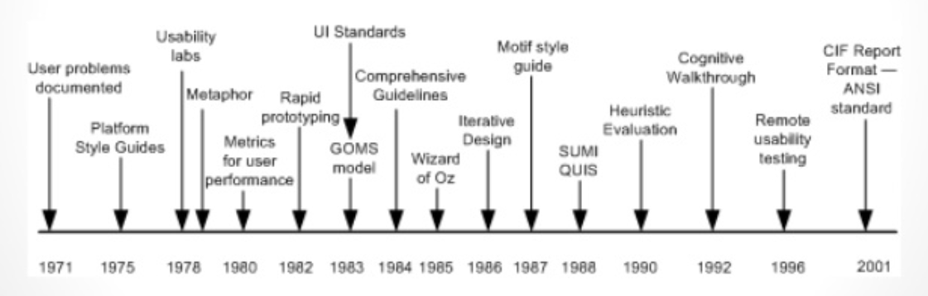
Usability evaluation
User were first used as the source of usability
feedback but models have been also used for over 20 years.
Expert feedback was developed in heuristic reviews and cognitive walkthroughs and has been used since
The early 90s.

Slide 4
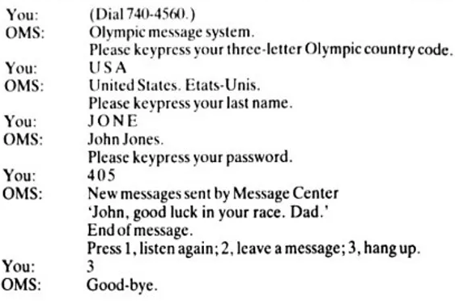
Usability and Evaluation
Mini-Case 1984 Olympic message system demonstrates:
You will not get it right the first time
You will get different answers when you use different methods of observation
You will need to come up with integrative solutions to problems
https://course.ccs.neu.edu/is4300f16/ssl/gould.pdf

Slide 5
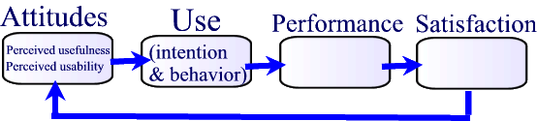
Usability and Evaluation
Figure 7.2 Attitudes, use, performance, and satisfaction
relationship

Slide 6
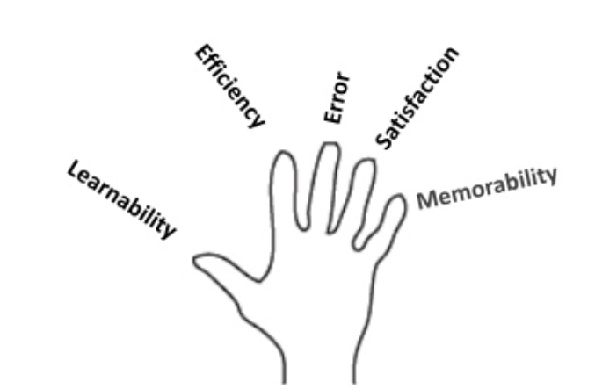
Usability and Evaluation
ISO (International Standards Organization) defines usability as “ a concept comprising the effectiveness, efficiency, and satisfaction with which specified users can achieve specified goals in a particular environment”

Slide 7
TYPES OF USABILITY TESTING
QUALITATIVE
QUANTITATIVE
Focuses on collecting insights, findings, anecdotes about how people use the product.
Best for discovering problems in UX
More common than quantitative
Focuses on collecting metrics that describe that user experience.
Two most common metrics are: task success & time on task.
Best for collecting benchmarks

Slide 8
INSPECTION
Testing and evaluation of the design layout of the software system is done by the experts like software developers, specialists, and professionals to real users.
It provides expert’s views and opinions which are essential for development of various usability aspects of the software system.

Slide 9
INSPECTION
Cognitive Walkthrough
Heuristic Evaluation
Pluralistic Walkthrough
Action Analysis
Perspective-based Instruction
Consistency Inspection
Feature Inspection
Standard Inspection
Formal Usability Inspection

Slide 10
Usability evaluation
Goal Achievement indicators
success rate, failure rate, accuracy, effectiveness.
Work rate indicators
speed, completion rate, efficiency, productivity, productivity gain
Operability indicators of the user’s ability to make use of the system features
error rate, problem rate, function usage
Knowledge acquisition indicators of the user's ability and effort in learning to use the system
learnability and learning

Slide 11
Usability and Evaluation
1. Time to complete a task 2. Number of user commands to complete task 3. Fraction of task completed 4. Fraction of task completed in a given time 5. Number of errors 6. Time spent on errors 7. Frequency of online help used 8. Number of available commands not used 9. When task is repeated, ratio of successes to failures 10. Fraction of positive comments made by user 11. Fraction of good to bad features recalled by user 12. Number of expressions of frustration and satisfaction 13. Number of times user loses control over system 14. Number of times the user needs to devise a way of working around the problem/system.

Slide 12
Usability and Evaluation
Methods of usability assessments include:
Thinking aloud (protocol analysis)
Observation
Interviews
Focus groups
Automatic logs
Questionnaires

Slide 13
Usability and Evaluation
Cognitive Walkthrough (Polson et al, 1992)
* Task description from the first-time user's viewpoint. Include any special assumptions about the state of the system assumed when the user begins work.
* Action sequence: Make a numbered list of the atomic actions that the user should perform to accomplish the task.
* Anticipated users: Briefly describe the class of users who will use this system. Note what experience they are expected to have with similar or previous versions.
* User's initial goals: List the goals the user is likely to form when starting the task. If there are other likely goals list them, and estimate for each what percentage of user are likely to have them.

Slide 14
INQUIRY
Evaluators obtain information about users’ likes, dislikes, needs and understand by talking to them, observing users using the system in real life, letting users answer questions verbally or in written form.

Slide 15
inquiry
Field Observation
Contextual Inquiry
Focus Groups
Survey/Questionnaires
Journaled Sessions
Screen Snapchats
Self-reporting Logs

Slide 16


Focus Groups / Survey / Questionnaire
Focus Groups
Formal, structured interactive events with users, asking users about their opinions and experiences regarding the product
Survey / Questionnaires
Surveys are recorded interactive interviews with users, not structured like contextual inquiries or formally organized like focus groups.
Questionnaires are written lists of questions distributed to users. Used to identify usability issues after the product has been released

Slide 17
Usability and Evaluation
Ben Shneiderman’s Questionnaire for user satisfaction
Laura Slaughter†, Kent L. Norman†, Ben Shneiderman* Assessing Users' Subjective Satisfaction with theInformation System for Youth Services
https://www.examples.com/education/questionnaire-for-customer-satisfaction.html

Slide 18
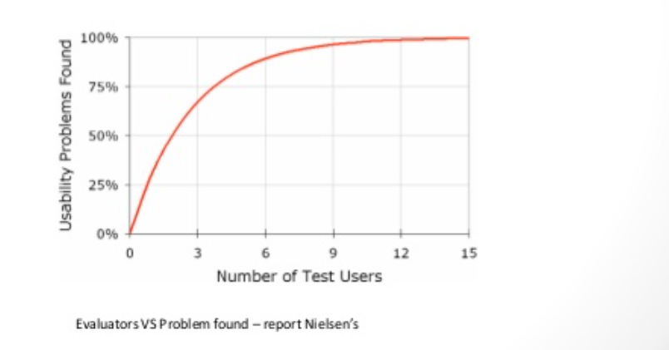
Number of users

Slide 19
Assignment 1
Watch the following videos and select the proper usability method to measure the usability of you own project
https://www.youtube.com/watch?v=mZgL3mMxwBI
https://www.youtube.com/watch?v=KCJ5y34nJgo

